Slide 1




Critical Thinking S1 2023
Tutor: Dr. Iwan Williams
Email: iwan.williams1@monash.edu

Slide 2
Review Quiz!

Slide 3
Lecture 10:
Informal fallacies

Slide 4
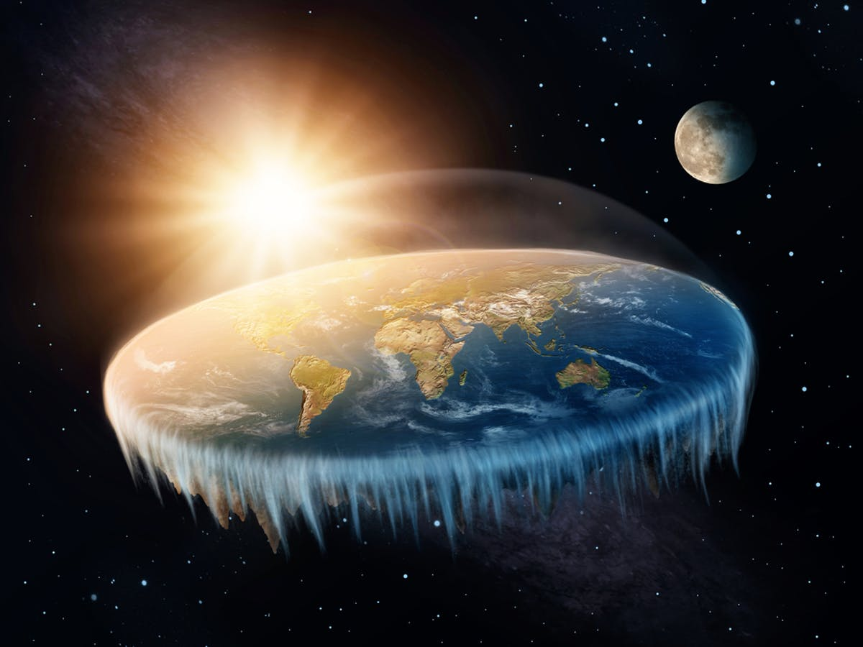
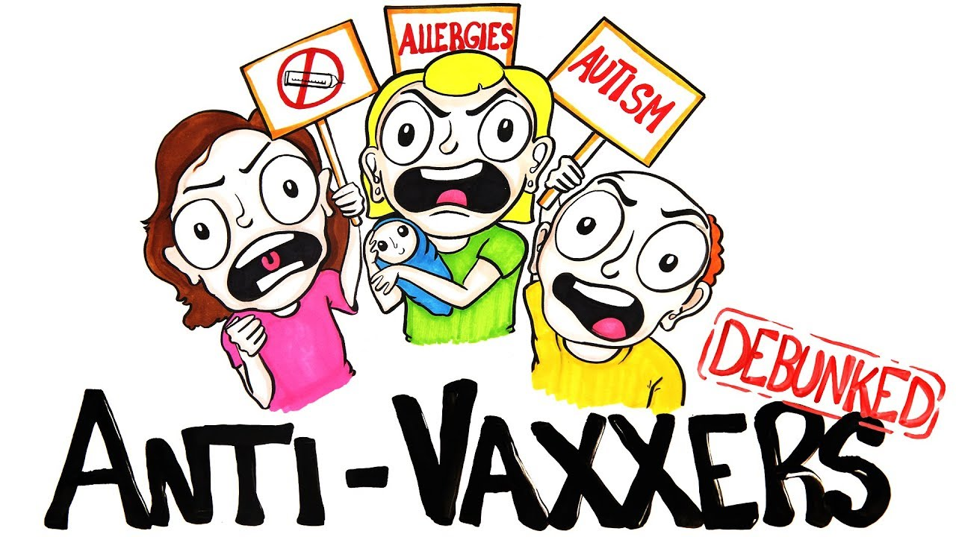
What makes an good argument?
Politicians (etc) focus
A good argument is one that convinces the audience that the conclusion is true.
Our focus
A good argument is one that the audience should be convinced by because it provides an objectively good reason for accepting the conclusion.
Is the argument valid?
Are the premises acceptable as true?

Slide 5
Fallacies
In a fallacious argument there is an inappropriate connection between the premises and conclusion
Formal fallacies: A logical error due to the form or structure of an argument.
Informal fallacies: An inappropriate form of argument that doesn’t involve an error in form or structure:
E.g. making flawed assumptions, adding irrelevant claims, misusing language, distorting an opponent’s position etc.

Slide 6
Formal Fallacies: Affirming the consequent
P1. If someone is a philosopher (A), then they are wise (B)
P2. John is wise (B)
Therefore,
C. John is a philosopher (A)
If A (antecedent), then B (consequent)
B (consequent)
Therefore,
A (antecedent)

Slide 7
Formal Fallacies: Denying the antecedent
P1. If someone is a philosopher (A), then they are wise (B)
P2. John is not a philosopher (not A)
Therefore,
C. John is not wise (not B)
If A (antecedent), then B (consequent)
Not A (antecedent)
Therefore,
Not B (consequent)

Slide 8
Informal fallacies

Slide 9
(1) Questionable assumptions
Remember week 4!
By itself, the fact that an argument relies on an assumption doesn’t make it a bad one.
But if an argument relies on false assumptions then it cannot be sound:
Cigarette smoking has been shown to be a health hazard; therefore, governments should ban all advertisements that promote smoking.
P1. Cigarette smoking has been shown to be a health hazard
A2. Governments should ban advertisements that promote activities that are a health hazard.
Therefore,
C. Governments should ban all advertisements that promote smoking.
False!

Slide 10
(2) Questionable appeals to authority & (3) Questionable attacks on authority (ad hominem)
Remember week 5!
Some appeals to authority are legitimate but others are illegitimate.
(Consider: is the source in a position to know, are they reliable/trustworthy and we can corroborate their claim?)
On the other hand it is equally fallacious to criticise the character or credibility of a source in an attempt to reject the claims they make while failing to engage with their arguments for those claims.
This is ad hominem
Ad hominem (aka. personal attack) is the fallacy of attacking a person without engaging with the argument that they offer.

Slide 11
(3) Ad hominem
Jill Goodwin says we should ban fracking, but what does she know, she’s a representative of the bleeding-heart, do-gooding, lentil-eating, sandal-wearing Green Party, for heaven’s sake!

Slide 12
More subtle instances
"In order to be fair, I won’t even mention my opponent's drinking problem."
"I don't care if other people say X about you!”
It’s adding an irrelevant premise for psychological effect.

Slide 13
(4) Circular reasoning (begging the question)
An argument is circular if the conclusion is used as support for itself (explicitly or implicitly).
Freedom of speech is important because people should be able to speak freely
The death penalty is wrong because killing people is immoral
Ghosts are real because I have had experiences with them myself
Left-handed people are better painters because right-handed people can't paint as well

Slide 14
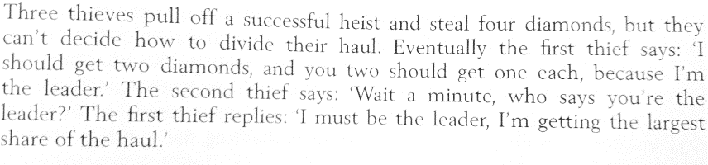
(4) Circular reasoning
Whoever gets the largest share is the leader and the leader gets the largest share, it’s circular

Slide 15
What if the conclusion/premise of a valid circular argument is true? Wouldn’t that mean it’s good?
No.
If we don’t already accept the conclusion, a circular argument doesn’t give us any reason to update our beliefs.
1. Climate change is real Therefore, C: Climate change is real
Giving arguments that are circular doesn’t get us anywhere. They aren’t constructive.
When giving arguments you should try not to use any premises that will obviously not be accepted by people who disagree with you about the conclusion.

Slide 16
(5) Equivocation
The use of ambiguous language to intentionally or unintentionally mislead the audience.

Slide 17
Ambiguity – multiple meanings
Semantic ambiguity: A word or phrase is ambiguous if it has more than one accepted meaning.
Yesterday, I sat on the bank and caught three fish.
Yesterday I went to the bank and deposited a cheque.
Syntactic ambiguity arises when there is more than one way to interpret the grammatical structure of a sentence.
Laurie calls her mother when she's alone.
Juvenile Court Tries Shooting Defendant
Squad Helps Dog Bite Victim
Referential ambiguity arises when it is unclear which thing or group is being referred to.
Everybody is coming to the party.

Slide 18
(5) Equivocation
Ambiguous language by itself isn’t a problem, because in many cases it will be clear what the intended meaning of a premise or conclusion is.
The problem arises when an argument switches between different meanings of a word/sentence in a way which makes an unsound argument appear sound. This is equivocation:
The use of ambiguous language to intentionally or unintentionally mislead the audience.

Slide 19
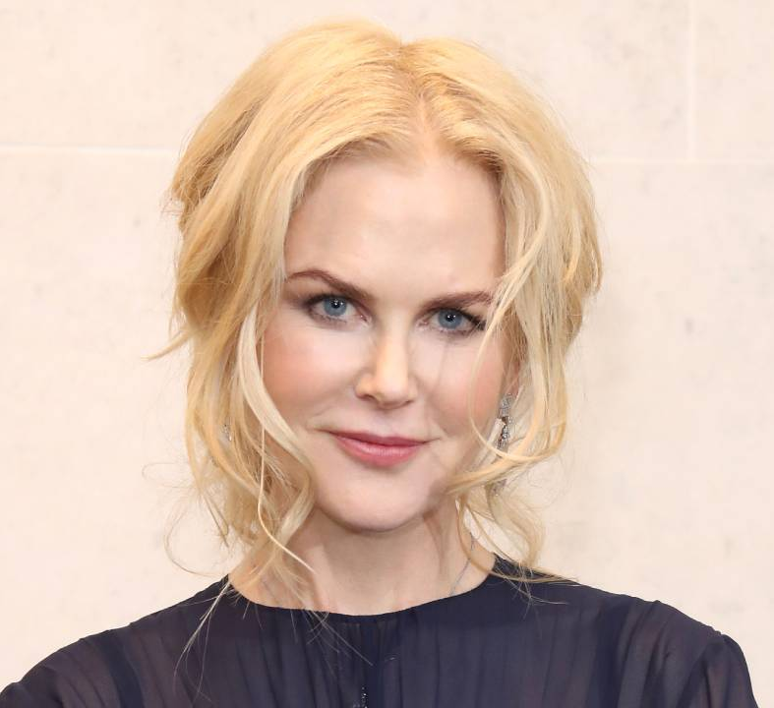

(5) Equivocation
Here’s an obvious example:
Nicole Kidman is a star.
Stars are enormous balls of hydrogen gas kept burning by nuclear reactions.
Therefore,
C: Nicole Kidman is an enormous ball of hydrogen gas kept burning by nuclear reactions.

Slide 20
(5) Equivocation
More examples:
P1. The priest told me I should have faith.
P2. I have faith that my son will do well in school this year.
Therefore,
C. The priest should be happy with me.
P1. A feather is light.
P2. What is light cannot be dark.
Therefore,
C. A feather cannot be dark.

Slide 21
(5) Equivocation
Equivocations can be very subtle, and a person may not realize that they are using the same term in two different senses.
There can be real disagreement as to whether an argument involves an equivocation at all.
But that’s also why discovering an equivocation can mean real progress!

Slide 22
Example
1. Laws can only be created by a law-maker.
2. There are many laws of nature.
Therefore:
C. There must be a law-maker (God) who created the laws of nature.
Which different meanings of “law” are being used here? Why is this a problem for the argument?

Slide 23
Example
1. Laws can only be created by a law-maker.
2. There are many laws of nature.
Therefore:
C. There must be a law-maker (God) who created the laws of nature.
‘Law’ can be interpreted to mean:
A. A code of conduct or set of rules of behaviour, enforced with penalties.
In sense A, premise 1 is true, but 2 is false.
B. A regularity in nature.
In sense B, premise 2 is true, but 1 is question begging.

Slide 24
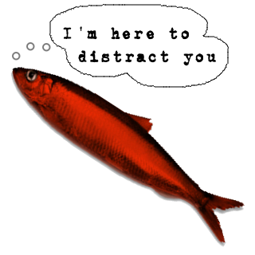
(6) Red herring
A red herring argument is a fallacy of irrelevance: it uses premises that are logically unrelated to the conclusion to distract attention from the actual issue.
Named after the practice of dragging a smelly, salt-cured (and thus reddish) herring across the trail of an animal tracked by dogs
Example:
The judge should rule against the charge of false accounting against the chief executive of Utilicorp. The CEO is very popular with stakeholders, and presides over an extremely healthy company.

Slide 25
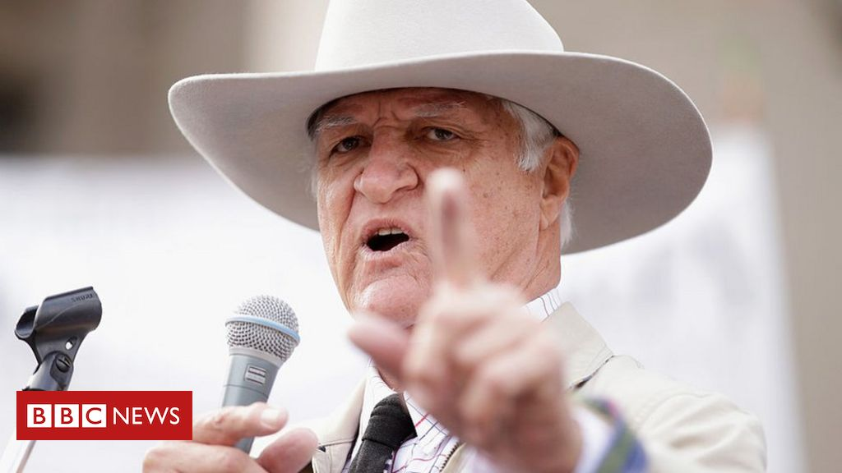
Bob Katter on same-sex marriage
“…people are entitled to their sexual proclivities. Let there be a thousand blossoms bloom, as far as I am concerned. But I ain't spending any time on it because in the meantime, every three months, a person is torn to pieces by a crocodile in north Queensland.”

Slide 26
(7) Slippery Slope
A slippery slope argument aims to show that a proposition is unacceptable because if accepted, it would inevitably lead to a sequence of increasingly unacceptable events.

Slide 27
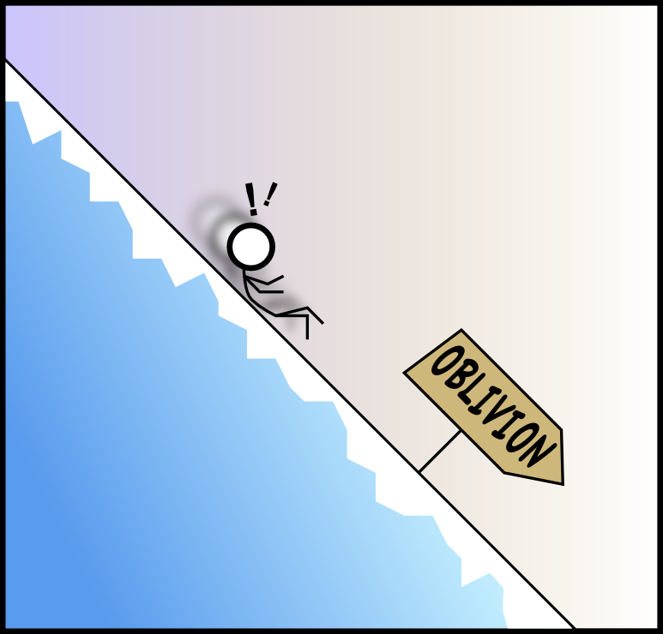
(7) Slippery slope
We must not decriminalize marijuana, because that would lead to a casual attitude about drug use, to greater demand for other drugs, and ultimately to a widespread availability of all drugs!
P1. If cannabis use would be decriminalised, the use of harder drugs would increase
P2. We don’t want the use of harder drugs to increase
Therefore
C. Cannabis should not be decriminalised

Slide 28
(7) Slippery slope
If we would legalise voluntary euthanasia, it would not be long before involuntary euthanasia would start to happen.
Today late for ten minutes, tomorrow late for an hour, and then someday you will simply cease to show up.
If Texas adopts a personal income tax, I'm moving away. An income tax at the state level is just a first step to communism.
I don't think it's a good idea to lower the drinking age. Next thing we know kids will get to drive at age ten, and vote at fifteen. Let kids be kids and adults be adults.

Slide 29
(7) Slippery slope
Can slippery slope arguments they raise valid concerns?
Yes. A slippery slope argument raises valid concerns if each step is likely to cause a slide to the next step and if there are no practical ways to intervene and prevent the slide (i.e. if the slope is real).
Example:
You shouldn’t get just a few hours sleep before tutorials. Because if you get only a few hours sleep you’ll be sleep-deprived the next day. And if you’re sleep deprived then you wont be able to focus as clearly in class. And if you don’t focus as well in class then you won’t understand the material very well. And if you don’t understand the material very well your grades will suffer.
But often not all the if-then statements in the chain are true, or there is some practical way to stop the slide. In these cases a slippery slope argument is fallacious.

Slide 30
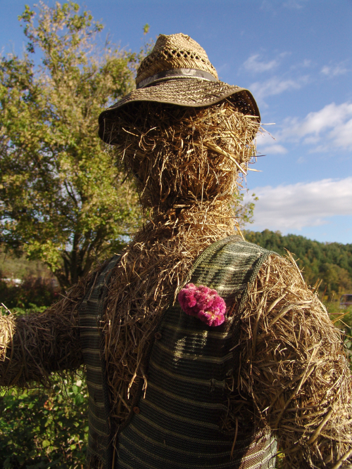
(8) Straw man
Ignoring an opponent’s actual position and argues against a distorted, exaggerated, or weaker one, or even a weak view that no one actually holds.
Straw men are easier to knock down
Claim: voluntary euthanasia should be legal
Response: How can you support giving doctors the right to end a person’s life just because they decide that the person‘s life is no longer worth living; no one should have that power over another person’s life, and doctors should not kill patients
Voluntary euthanasia is not about doctors making that decision

Slide 31
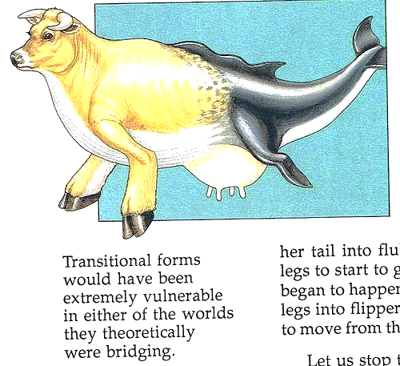
Straw man Example
The theory of evolution is ridiculous. According to the theory whales evolved from animals similar to cows. But how could an animal that was half a cow and half a whale possibly survive?

Slide 32
(9) False dilemma (black and white thinking)
A false dilemma, or false dichotomy, incorrectly presents two opposing views, options or outcomes as if they were the only possibilities: if one is true, the other must be false, or if you don’t accept one, you must accept the other. In doing so, it leaves out other alternative options.
Would you rather pursue your passion or be stuck in a 9-to-5 job?
Would you rather keep your job or be honest with your boss?
Would you rather invest in your future or enjoy your money now?

Slide 33
(9) False dilemma
I thought you were a good person, but you weren’t at church today.
America: Love it or hate it
Since there is nothing good on TV tonight, I will just have to get drunk.

Slide 34
“If you hamper the war effort of one side you automatically help that of the other. Nor is there any real way of remaining outside such a war as the present one. In practice, 'he that is not with me is against me'. The idea that you can somehow remain aloof from and superior to the struggle, while living on food which British sailors have to risk their lives to bring you, is a bourgeois illusion bred of money and security.”
George Orwell – Pacifism and the War

Slide 35
(9) False dilemma
Are all dillemmas false?
No. Sometimes there is just a choice between two alternatives, then you have a legitimate disjunctive syllogism. But when evaluating the truth of the “either or” statement, consider if its misleading - is there is a middle ground or more alternatives than the argument acknowledges? It might not be sound.

Slide 36
Common informal fallacies:
Questionable assumptions
Illegitimate appeals to authority
Ad hominem (personal attack)
Circular arguments (aka begging the question)
Equivocation
Red herring (aka smokescreen)
Fallacious slippery slope arguments
Strawman argument
False dilemma (aka false dichotomy)

Slide 37
Fallacy fallacy
It is also a fallacy to think that just because an argument commits a fallacy, that the conclusion is not true. It might be!

